Slide 1


E-Spare Part Store
Online Spare Part Shop
Presented By-
Adarsh N. Patil (233124)
Ashish L. Borole (233138)

Slide 2
Project Introduction
E Spare Part Store is a modern web-based platform designed to buy spare part by small retailers directly from wholesaler distributor. In earlier days shopkeeper get the products from the chain of 2 to 3 dealers due to which retailers get very less margin on that product. This platform establishes direct relationship between official distributor and retailer.
Additionally, all the business operations like placing orders, payment on customer side; managing products, stock on distributor side; managing delivery updates on delivery person side now can be done very easily in few clicks.
Administrator now can easily monitor entire chain of business operations online and if necessary, improve on it.

Slide 3
Objective (Purpose)
E-Spare part Store is an online web application for commercial vehicles spare parts. It is B2B in nature where Retailer can buy spare parts with the help of part number. Distributor will list all the available parts and Admin will govern the site operations.

Slide 4
Scope
Application has four types of Users. Admin, Dealer, Buyer, Admin & Delivery Person.
It provides facility for Sign Up & Sign In. After successful Signing In it will take you to the page which is designed for corresponding user.
Buyer user can search a part, view its details, purchase the product and can keep track of delivery progress.
Dealer user can add & remove his products, receive orders, prepare & dispatch it.
Admin user can perform various site governance operations.
Delivery user will update the delivery progress of products.

Slide 5
Technology Used
Front End: React JS
Back End: Java Spring Boot API.
Database: MySQL

Slide 6
S/W and H/W Requirements
Server Side:
Processor: Intel core i5 or above
HDD: 500 GB or above
RAM: 4GB or above
Database: MySQL
Client Side (minimum requirement):
Processor: Intel Dual Core
HDD: Minimum 80GB Disk Space
RAM: Minimum 2GB
OS: Windows 7, Linux

Slide 7
Functionalities - Module wise /user wise
E-Spare Part Store consists of three modules named below
1. Admin
2. Supplier
3. Customer
4.Delivery Person

Slide 8
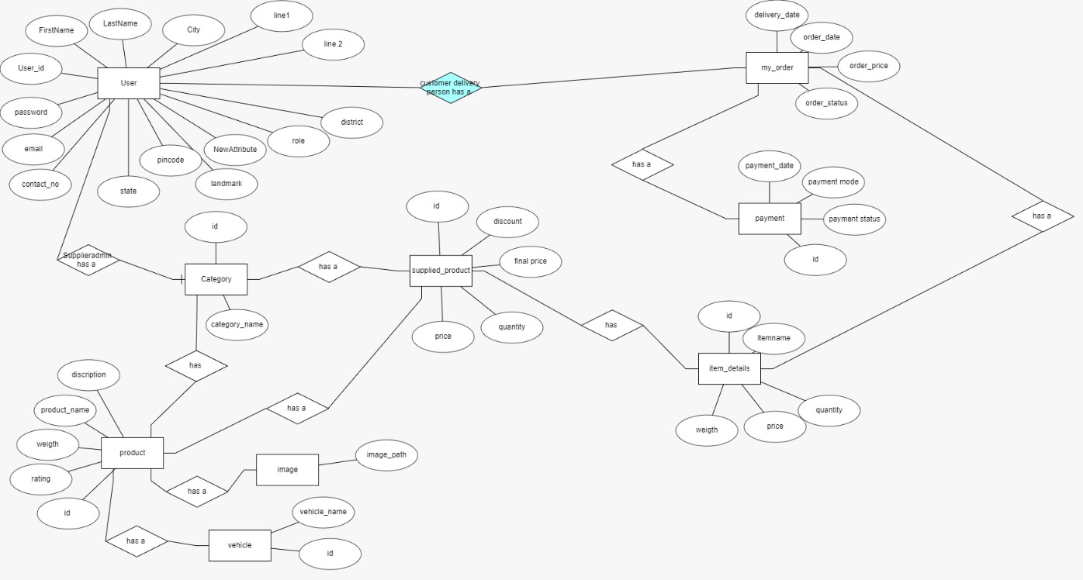
E-R Diagram

Slide 9
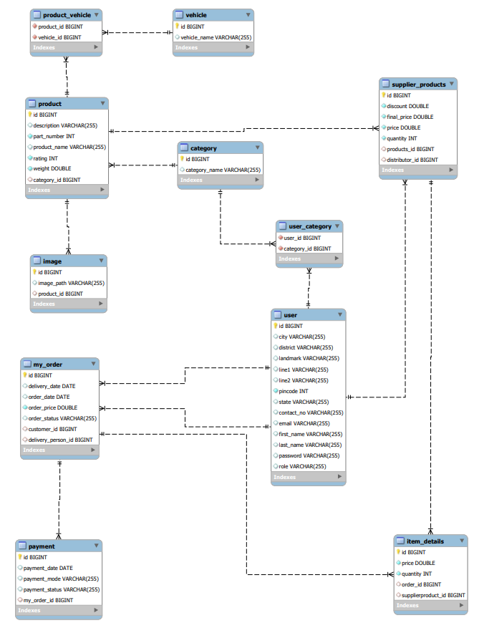
E-R Diagram(MySQL Auto generated)

Slide 10
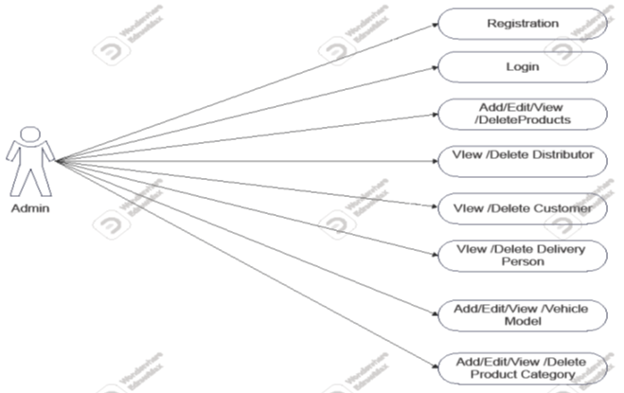
Use Case:Admin

Slide 11
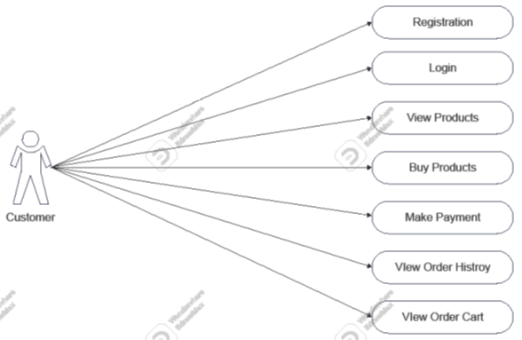
Use Case: Customer

Slide 12
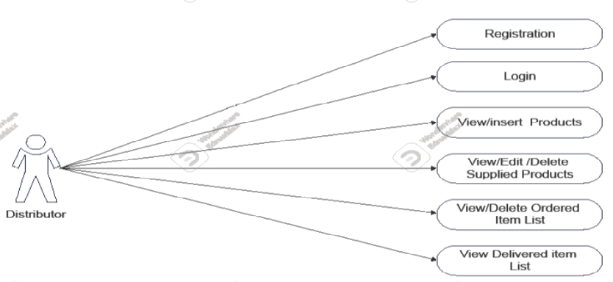
Use Case: Supplier

Slide 13
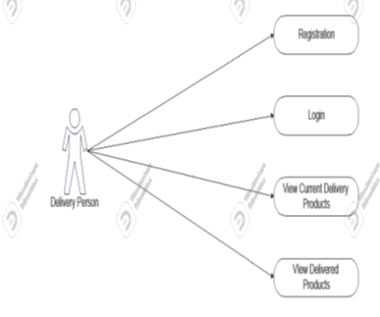
Use Case: Delivery Person

Slide 14
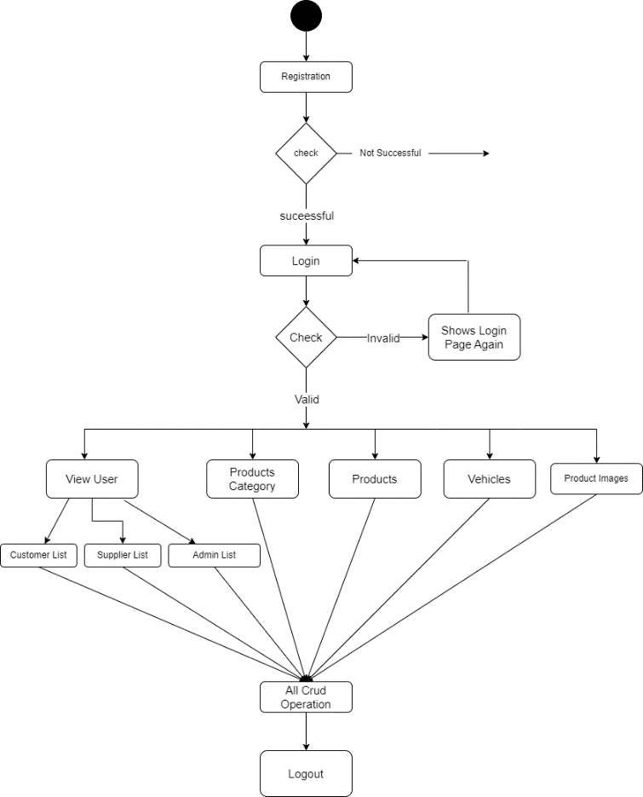
Activity Diagram Of Admin

Slide 15
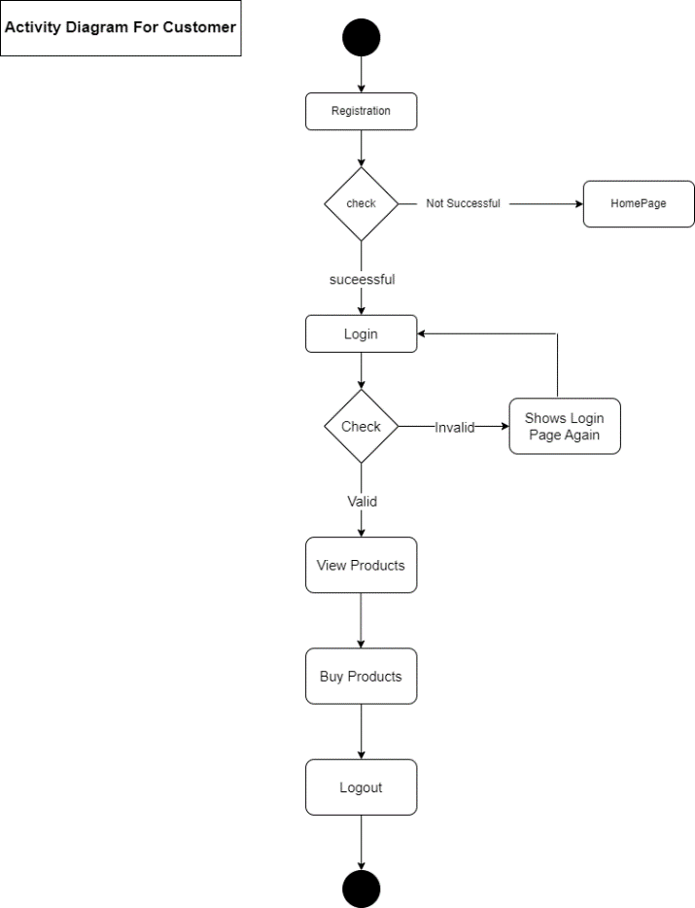
Activity Diagram Of Customer

Slide 16
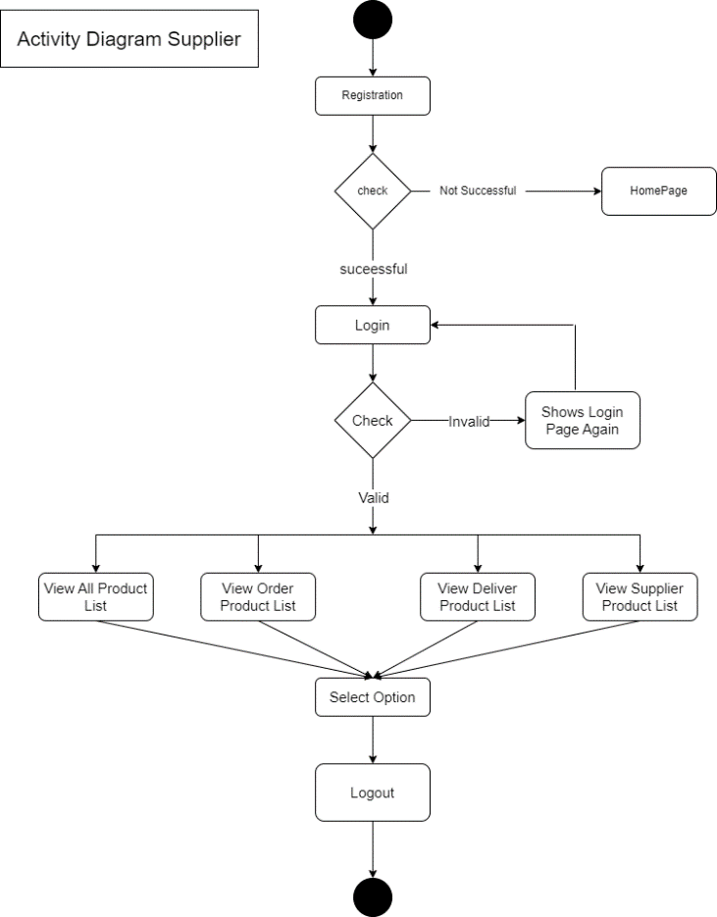
Activity Diagram Of Supplier

Slide 17
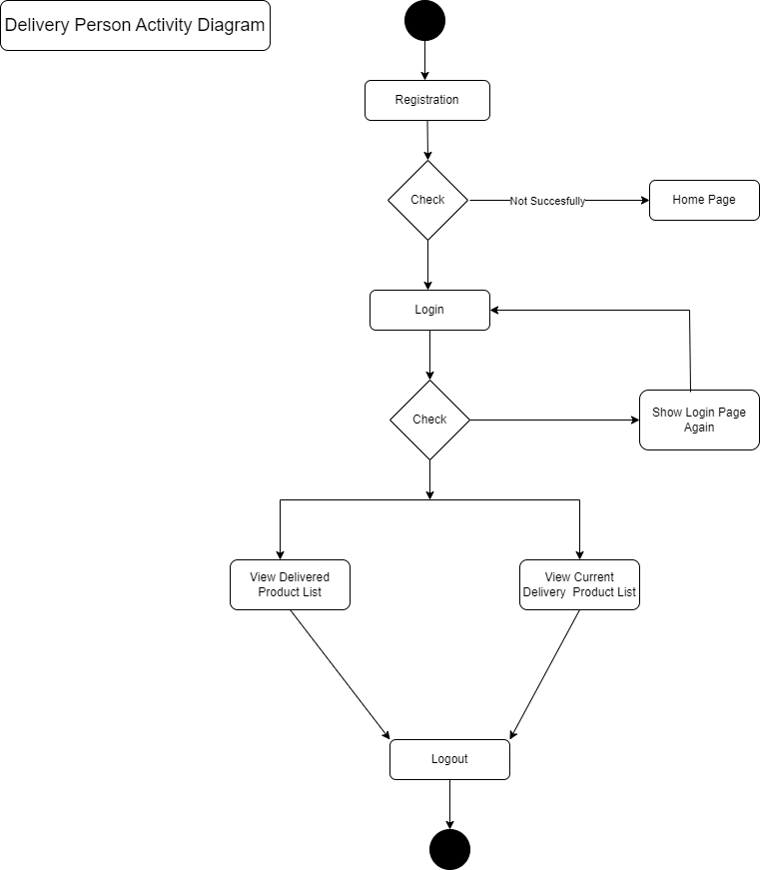
Activity Diagram Of Delivery Person

Slide 18
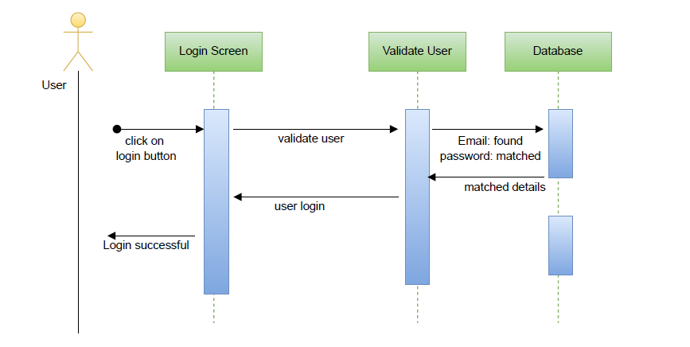
Sequence diagram for Login

Slide 19
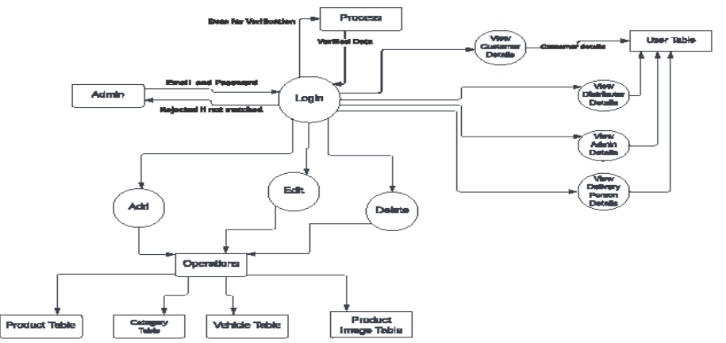
DFD diagrams for Admin

Slide 20
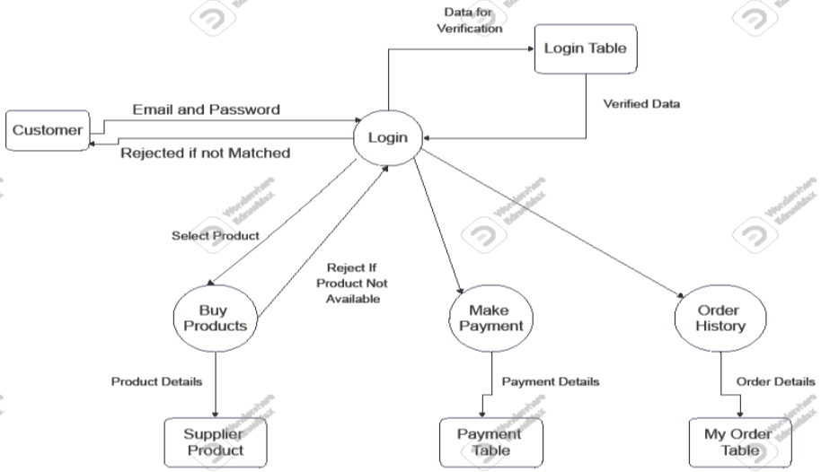
DFD diagrams for Customer

Slide 21
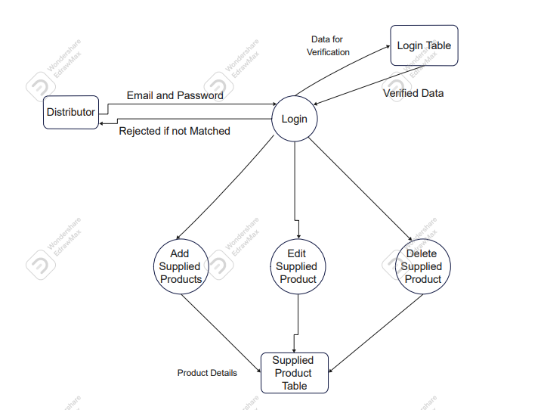
DFD diagrams for Distributor

Slide 22
DFD diagrams for Delivery Person

Slide 23
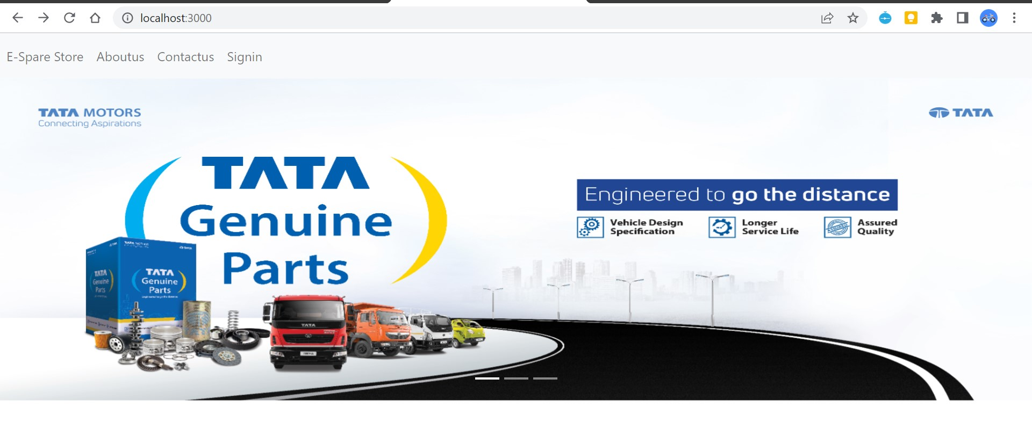
UI Screenshots

Slide 24
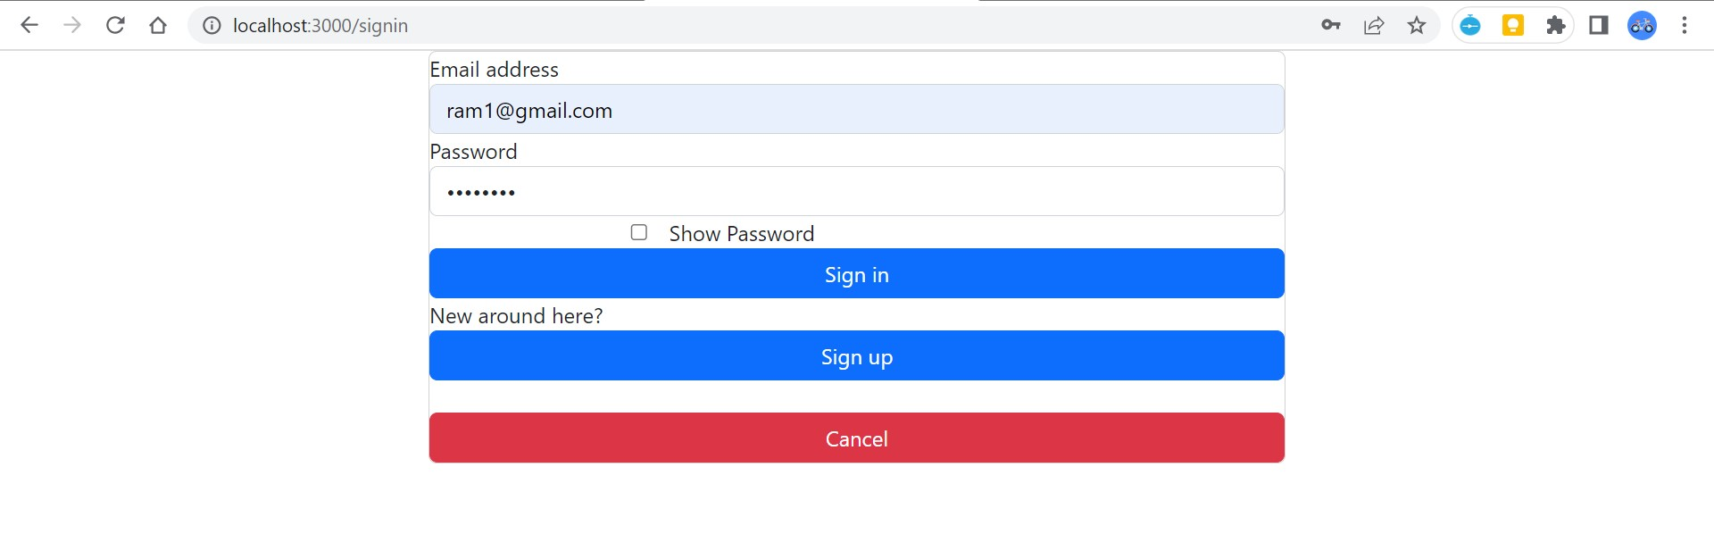

Slide 25
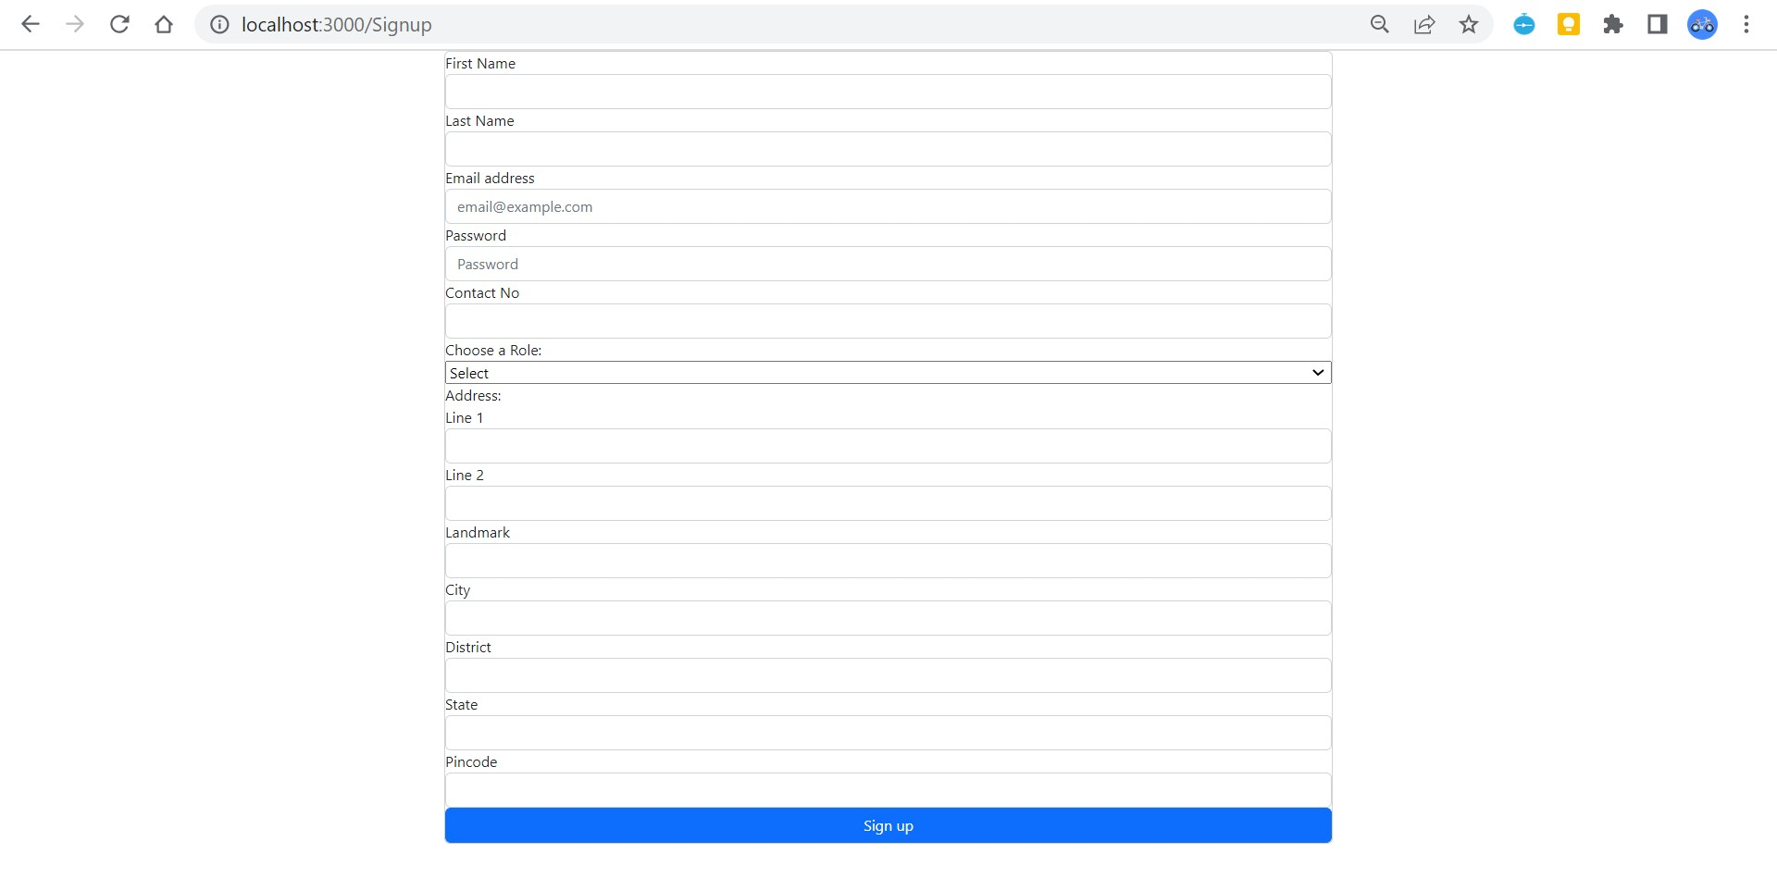

Slide 26
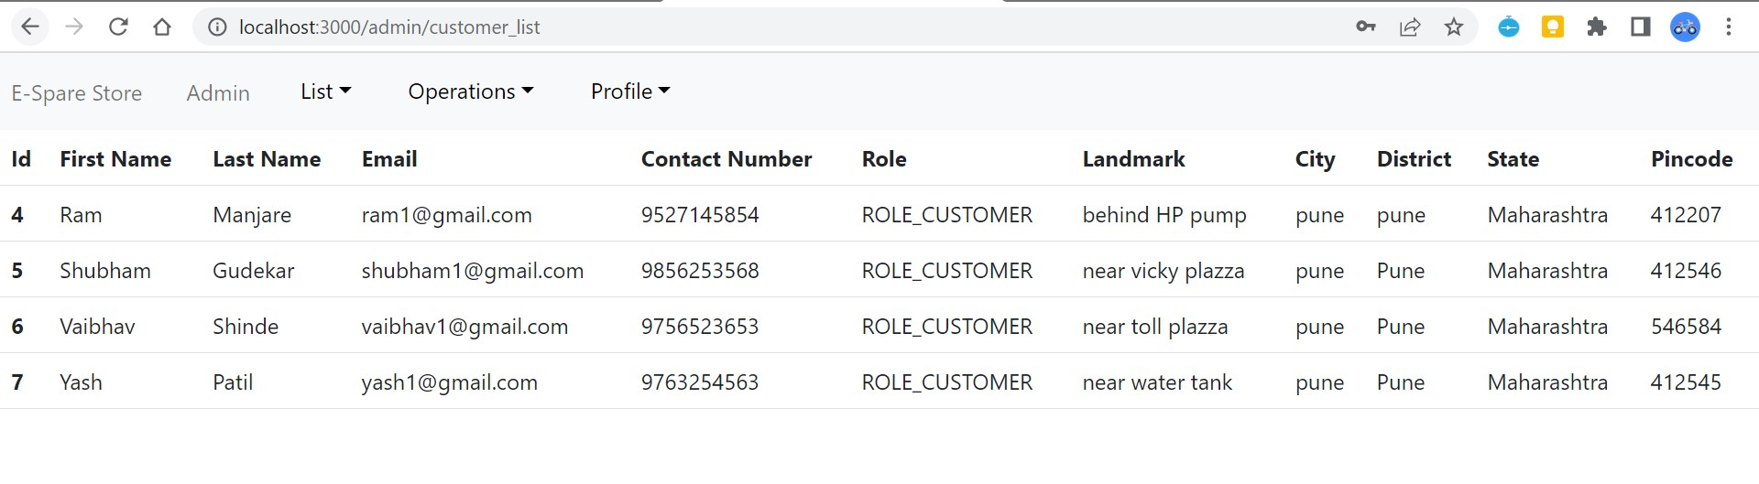

Slide 27
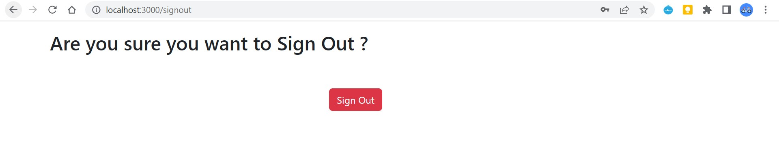

Slide 28
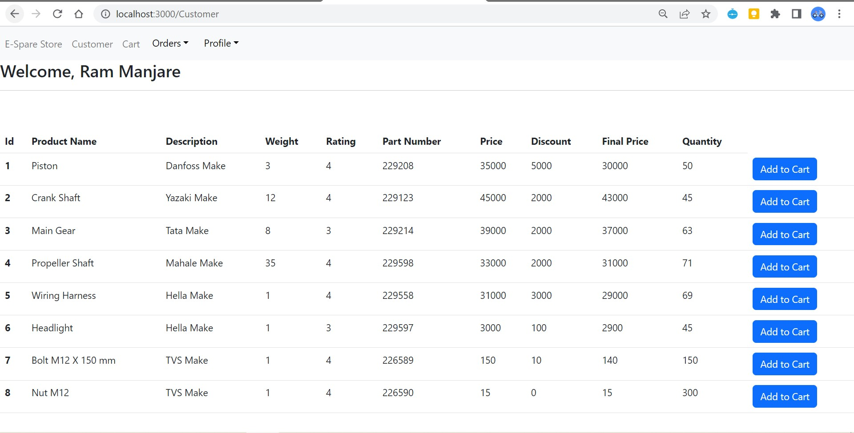

Slide 29
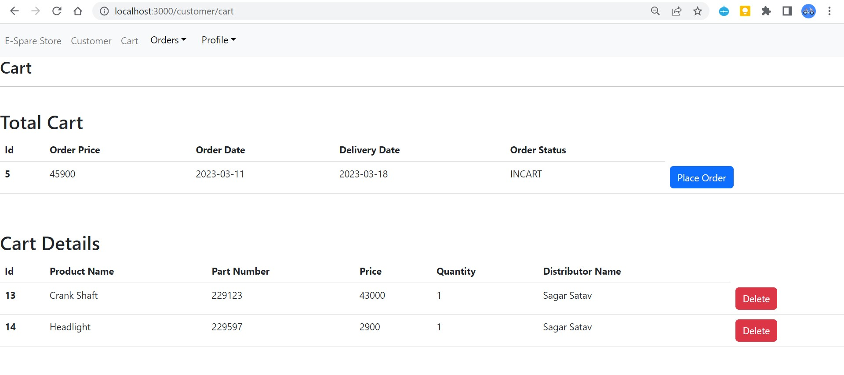

Slide 30
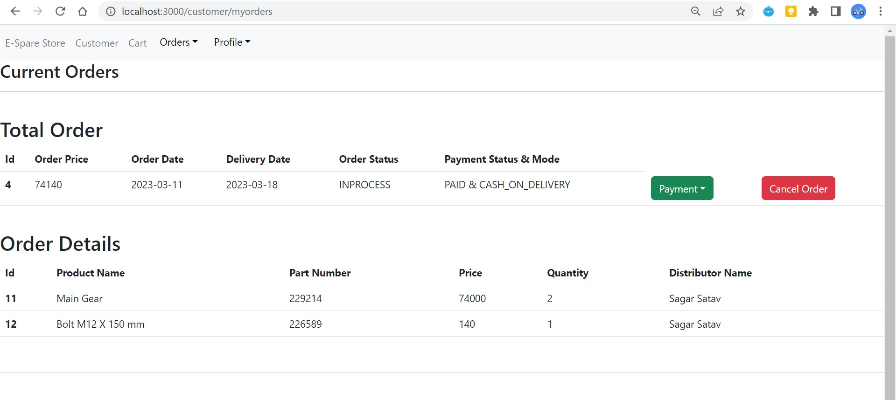

Slide 31
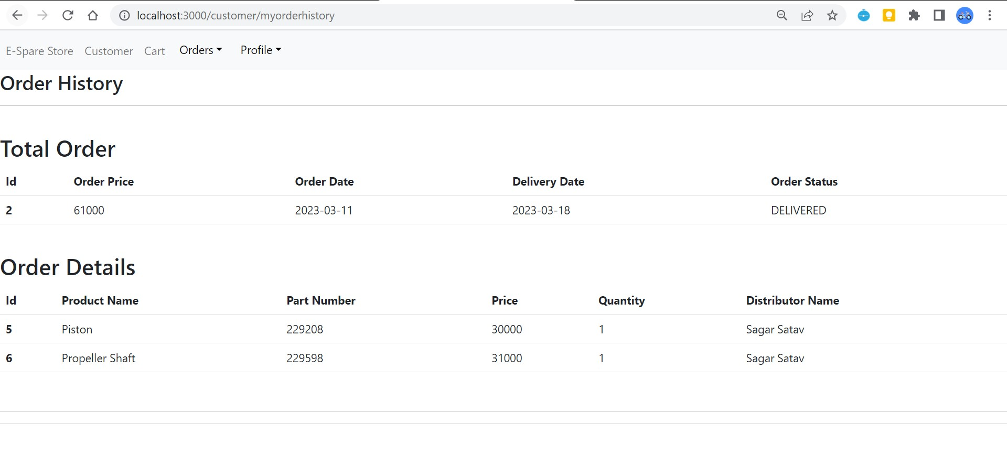

Slide 32
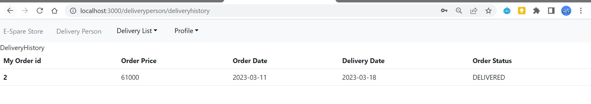

Slide 33
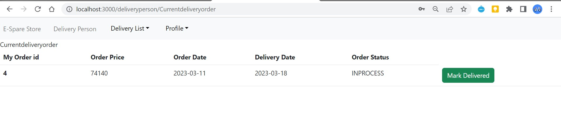

Slide 34
Future Extension
Future extensions for step-up of project.
Association with Google maps
Discount /offer management
Billing
Estimated time of implementation.
2 weeks
Benefits of future extension.
Attractive UI
Richer user experience
Robustness in application

Slide 35
Conclusion
The project titled e-Spare part shop was completed successfully. The system has been developed with much care and free of errors and at the same time it is efficient and less time consuming. The purpose of this project was to develop a web application.This project helped us in gaining valuable information and practical knowledge on several topics like designing web pages using React.js, usage of responsive templates and management of database using MySQL. The entire system is secured.
Also, the project helped us understanding about the development phases of a project and software development life cycle. We learned how to test different features of a project. This project has given us great satisfaction in having designed an application which can be implemented to any nearby shops or branded shops selling various kinds of products by simple modifications. There is a scope for further development in our project to a great extent. A number of features can be added to this system in future like providing admins more control over products so that each admin can maintain their own products. System may keep track of history of purchases of each customer and provide suggestions based on their history. These features could have implemented unless the time did not limit us.

Slide 36
References
https://www.w3schools.com/
https://react-bootstrap.github.io/components/carousel/
https://www.geeksforgeeks.org/reactjs-tutorials/
https://javaee.github.io/javaee-spec/javadocs/
https://reactjs.org/docs/getting-started.html

Slide 37
Thank You ☺

